Slide 1

Python Workshop
21/03/2018

Slide 2

Contents
Introduction
Install Python and pip
Where to search for help
Pip packages
Python in command line
Define basic variables
Install code editor
Create and test your first function

Slide 3

What is Python
Python is an interpreted, object-oriented, high-level programming language with dynamic semantics
(It let’s you do cools stuff with your computer)
It’s simple – it uses plain English
It’s readable – spacing is important
It’s wide-spread

Slide 4
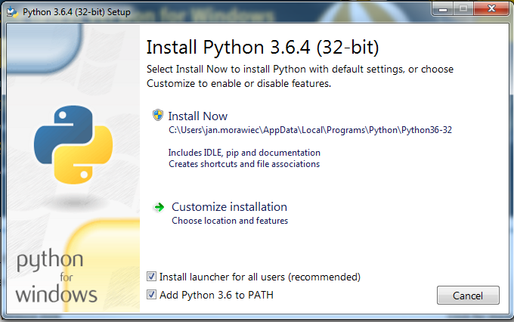
Install Python & pip
https://www.python.org/downloads/ - Download Version 3.x.x

Slide 5
HELP
Everything is (mostly) well documented
Google
https://docs.python.org/3.6/library/
https://stackoverflow.com

Slide 6
Pip
Pip manages all libraries (code someone else has written) that you use
Accessible through command line
On Windows
Click on Start
Type “cmd”
Press enter
Try it out
Install Pandas (a library used for working with data tables)
> pip install pandas
> Y
> pip list

Slide 7

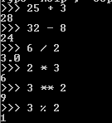
Run Python in Command Line
Open command line (Start > “cmd” > Enter)
Type in “python”
That’s it! Let’s try to use this as a calculator

Slide 8
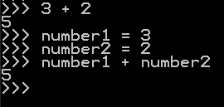
Variables
Numbers are not the only things Python can work with
For now, Strings, Integers, and Floats are most important
“This is a string” ‘This is also a string’ “””This is a multi-line string”””
2, 2.0, -2
Variables let you store the value you type in for the duration of the session
You can then do the same stuff with variables as you did before with just numbers
Variables can’t be named anything, basic text is fine, but some text (like print) is reserved for python built-in function. It also can’t start with a number, or a symbol.

Slide 9
Editor
Typing stuff into console all the time is boring, you want to reuse your code
Download a text editor that will help you write code
Atom - https://atom.io/
Use Atom to create a new file on your desktop called “coffee_machine.py”
File > New File > Ctrl + S
Because of the .py extension, Atom knows this is a Python file and it will highlight the important stuff for you
On the first line, type in print(“Hello world!”) and save

Slide 10
Built-in functions
https://docs.python.org/3.6/library/functions.html
print() – prints out any text string to command line
input() – allows user to provide your script with data
int() – tries to change the format of a variable to integer
def() – Let’s you define a new function!
If elif else statement – Evaluates a condition and returns a result

Slide 11
Running the script
Once happy with the code, save it (Ctrl + S), and run the file in command line
Start > “cmd” > Enter
cd Desktop
dir (do you see your file?)
python coffee_machine.py
?
Profit

Slide 12
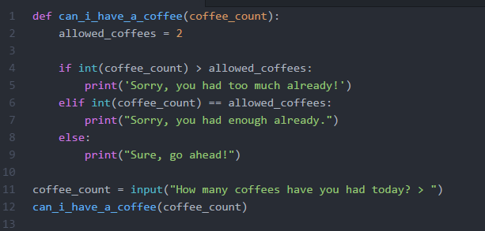
Your first function
Let’s delete the first line in the coffee_machine.py file
At the end of this tutorial, we will end up with this

Slide 13
Charlotte House, 2 South Charlotte Street Edinburgh, EH2 4AW Tel: + 44 (0)131 659 9810 www.eighty-days.com

